Slide 1
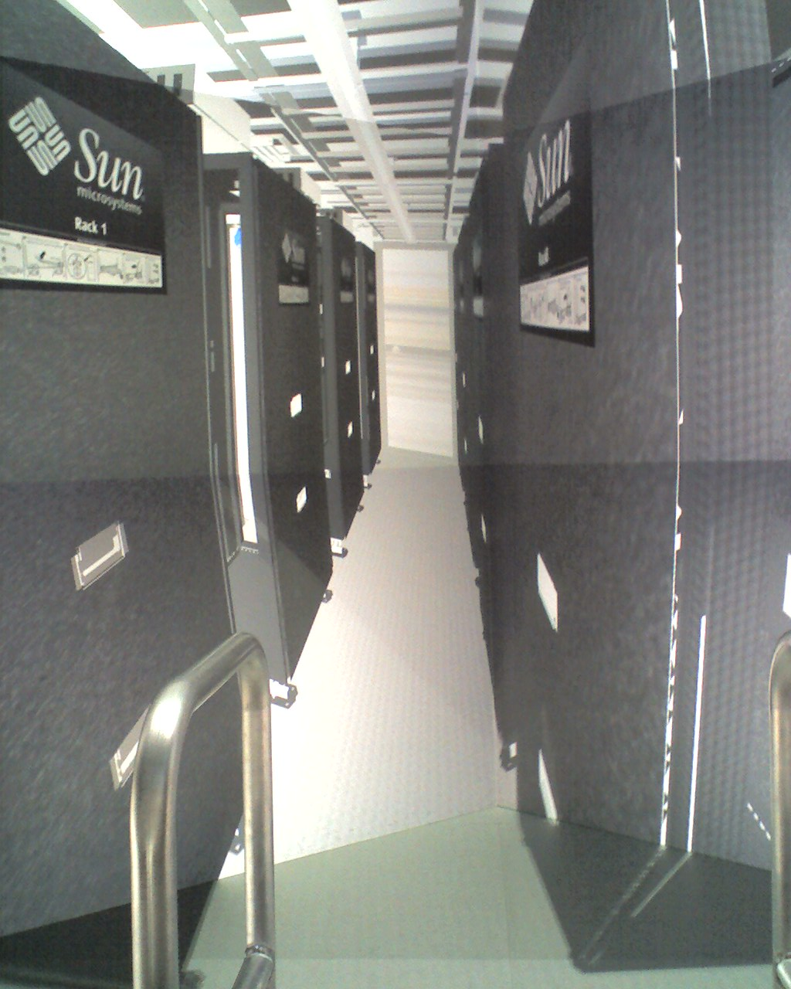
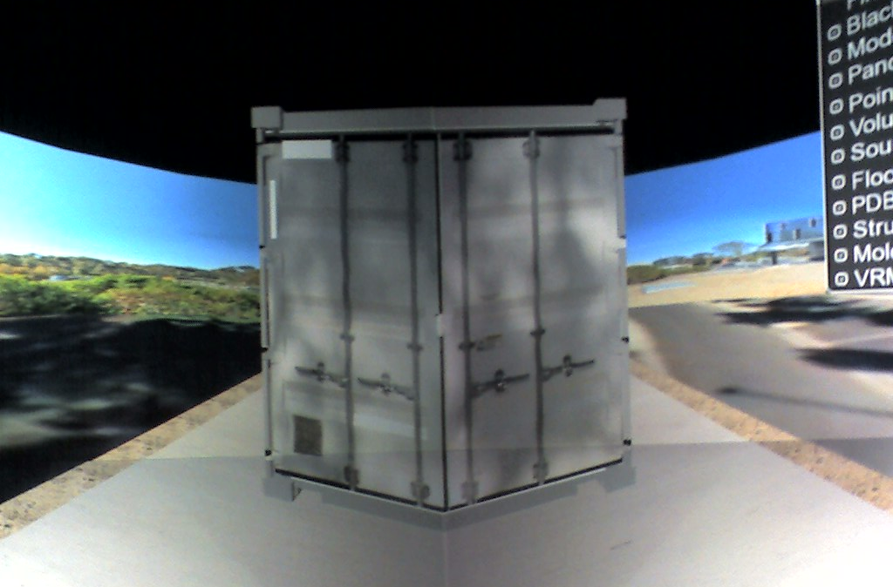
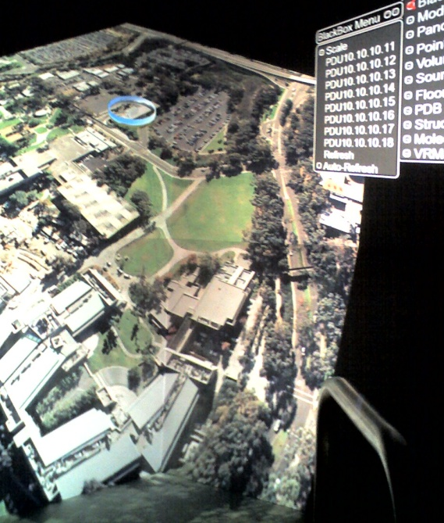
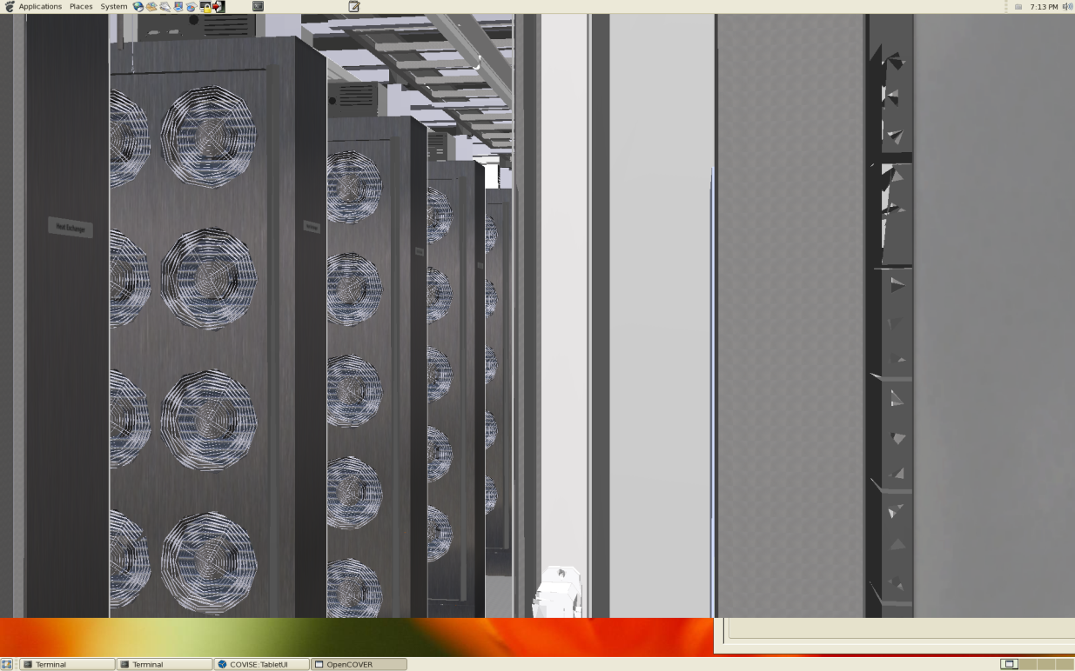
Using Virtual Reality to Monitor the GreenLight Instrument
Jürgen P. Schulze, Ph.D.
Project Scientist
Calit2/UCSD
July 1st, 2009

Slide 2
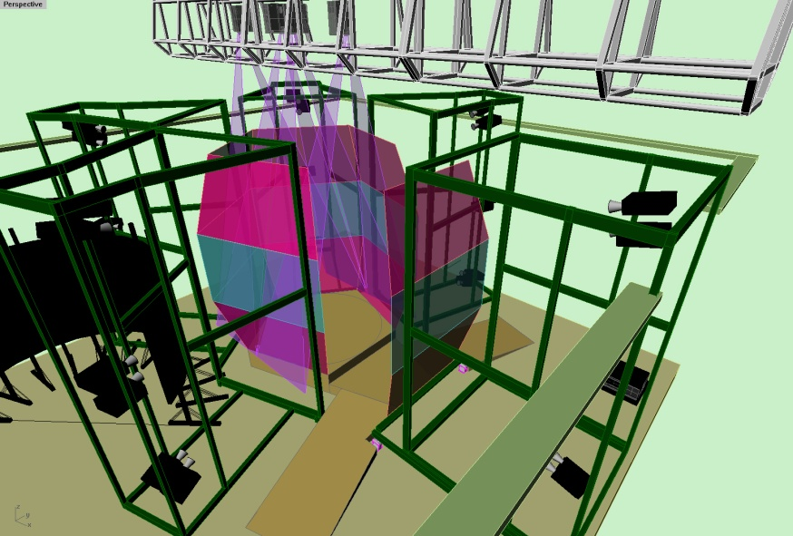
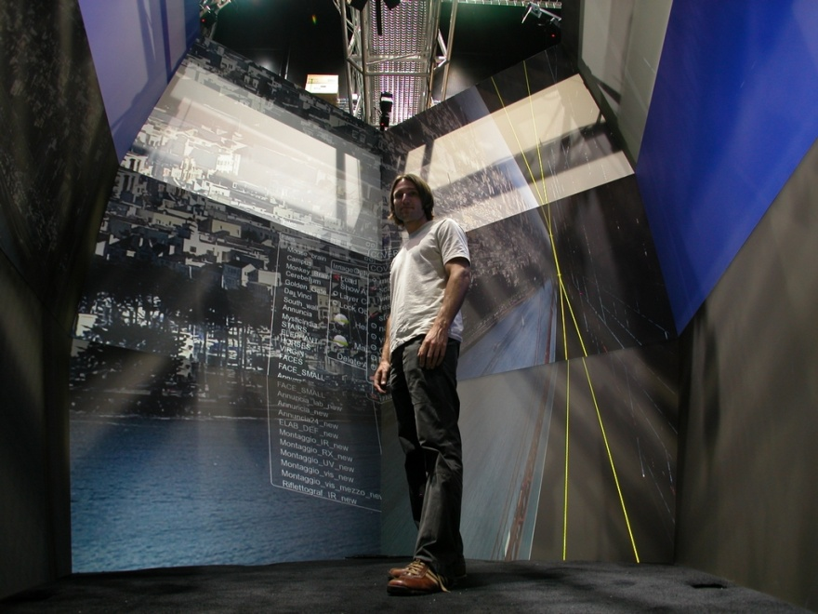
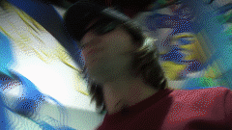
The StarCAVE
360 degree immersive virtual reality
15 screens on 5 walls, ~8 x 4 foot each, plus floor projection
Passive stereo, circular polarization
18 Dell XPS PCs with Quad Core Intel CPUs
Dual Nvidia Quadro 5600 graphics cards per node
34 JVC HD2k (1920x1080 pixels), ~34 megapixels per eye
Optical tracking system with four cameras by ART
CentOS 5.2 Linux
ROCKS cluster management software
Trackd tracker interface

Slide 3
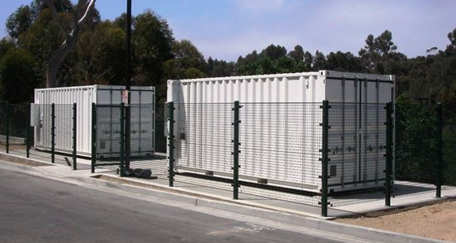
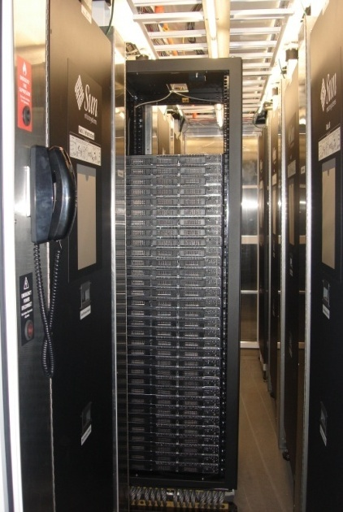
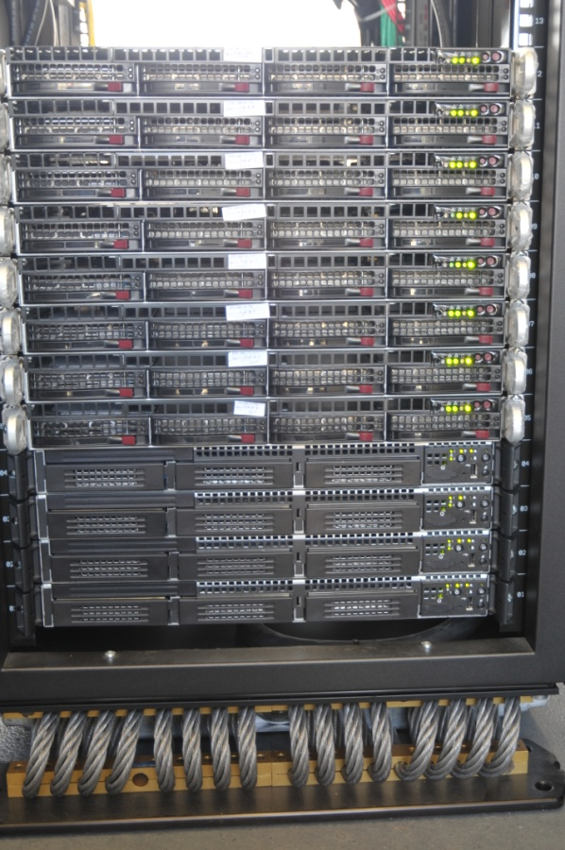
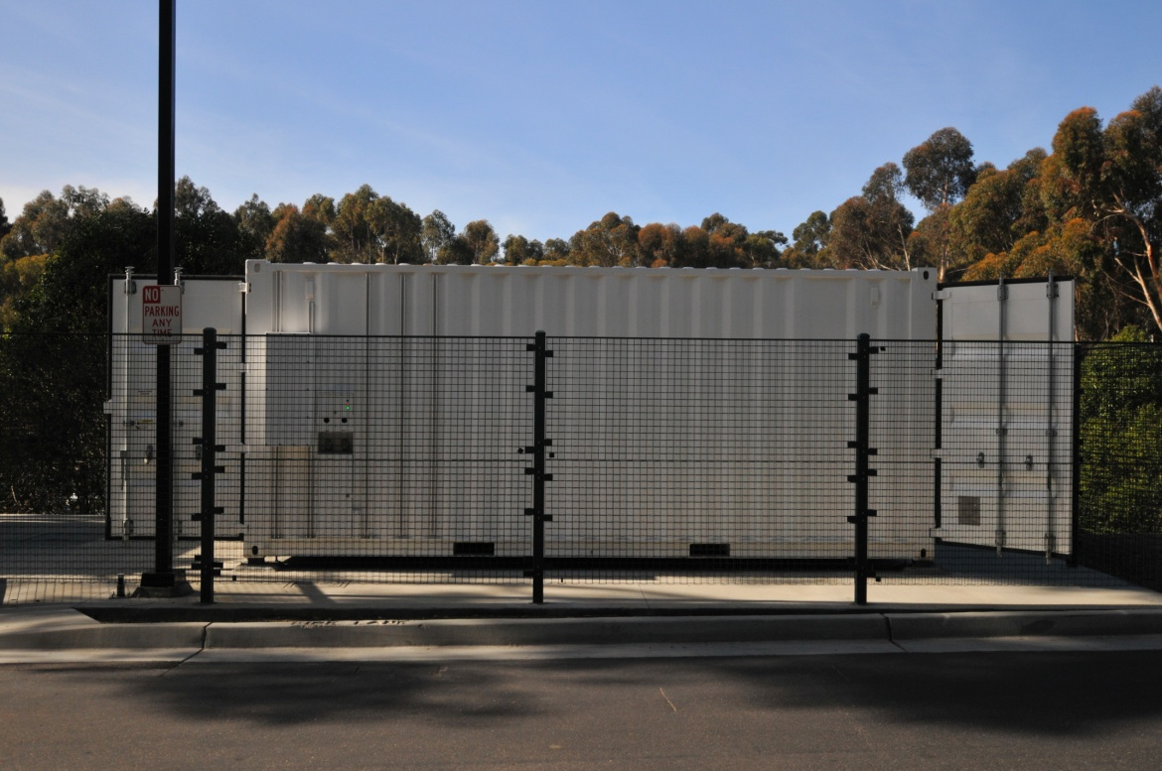
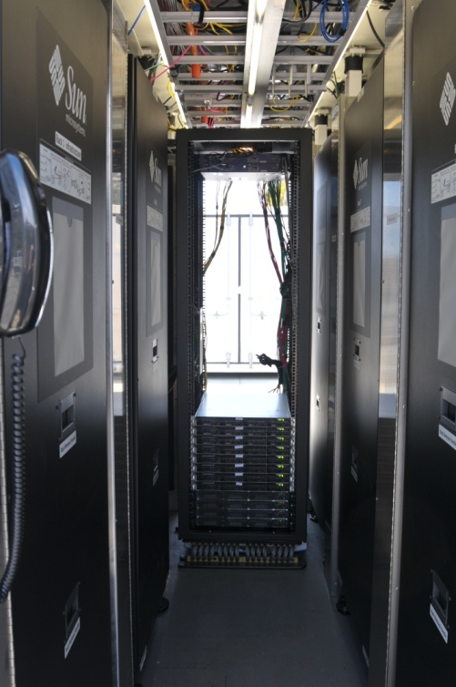
SUN Mobile Data Center (Blackbox)

Slide 4
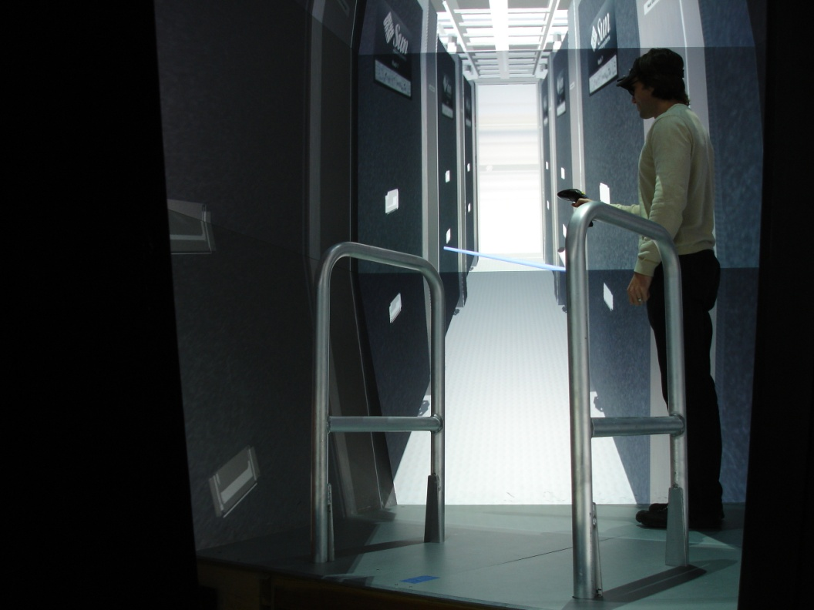
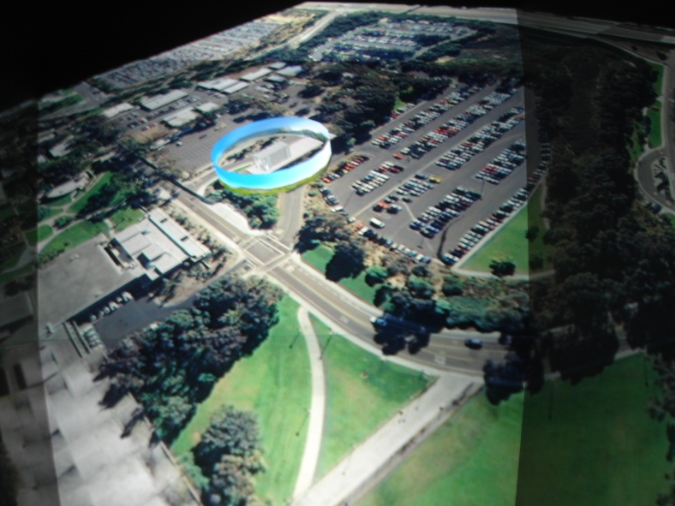
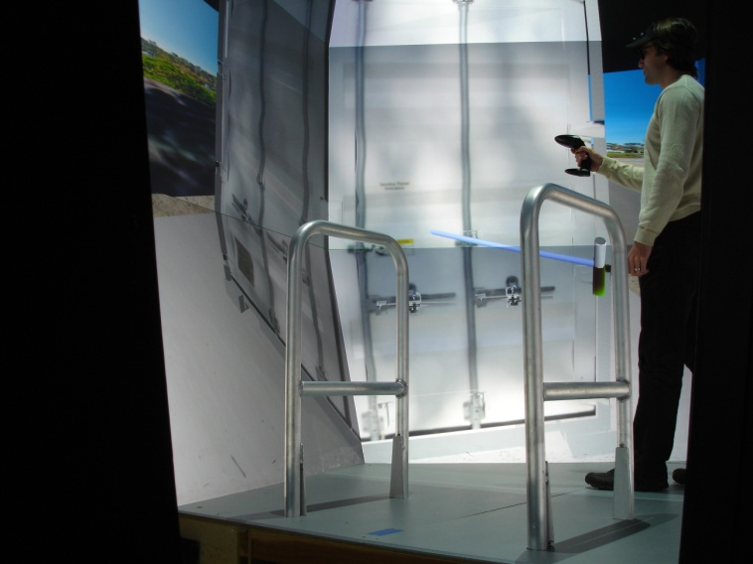
The Blackbox in the StarCAVE

Slide 5
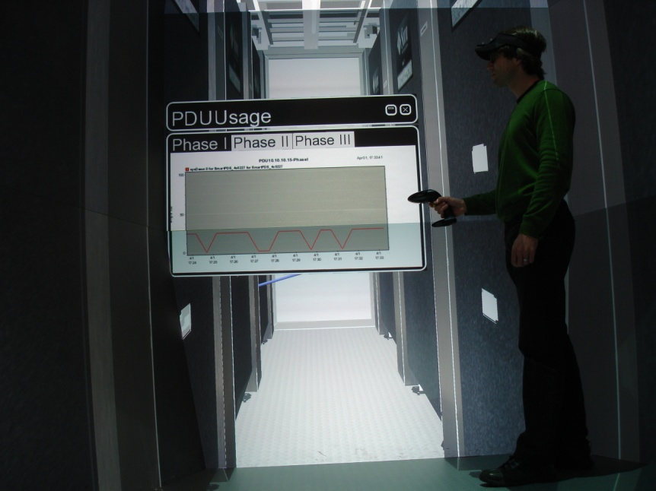
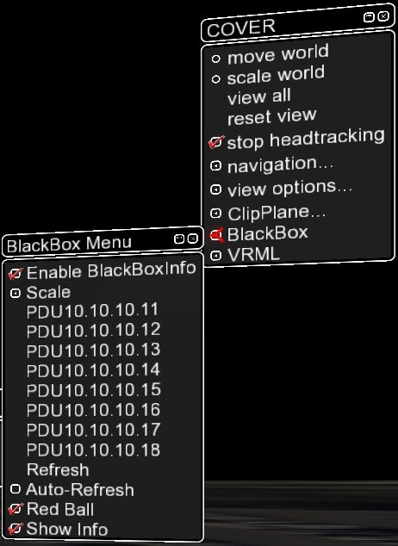
Real-Time Display of Power Consumption
Currently all eight PDUs are supported
All three phases on each PDU are supported
Several scalings available
Graphs generated by downloading PDU generated graph images

Slide 6
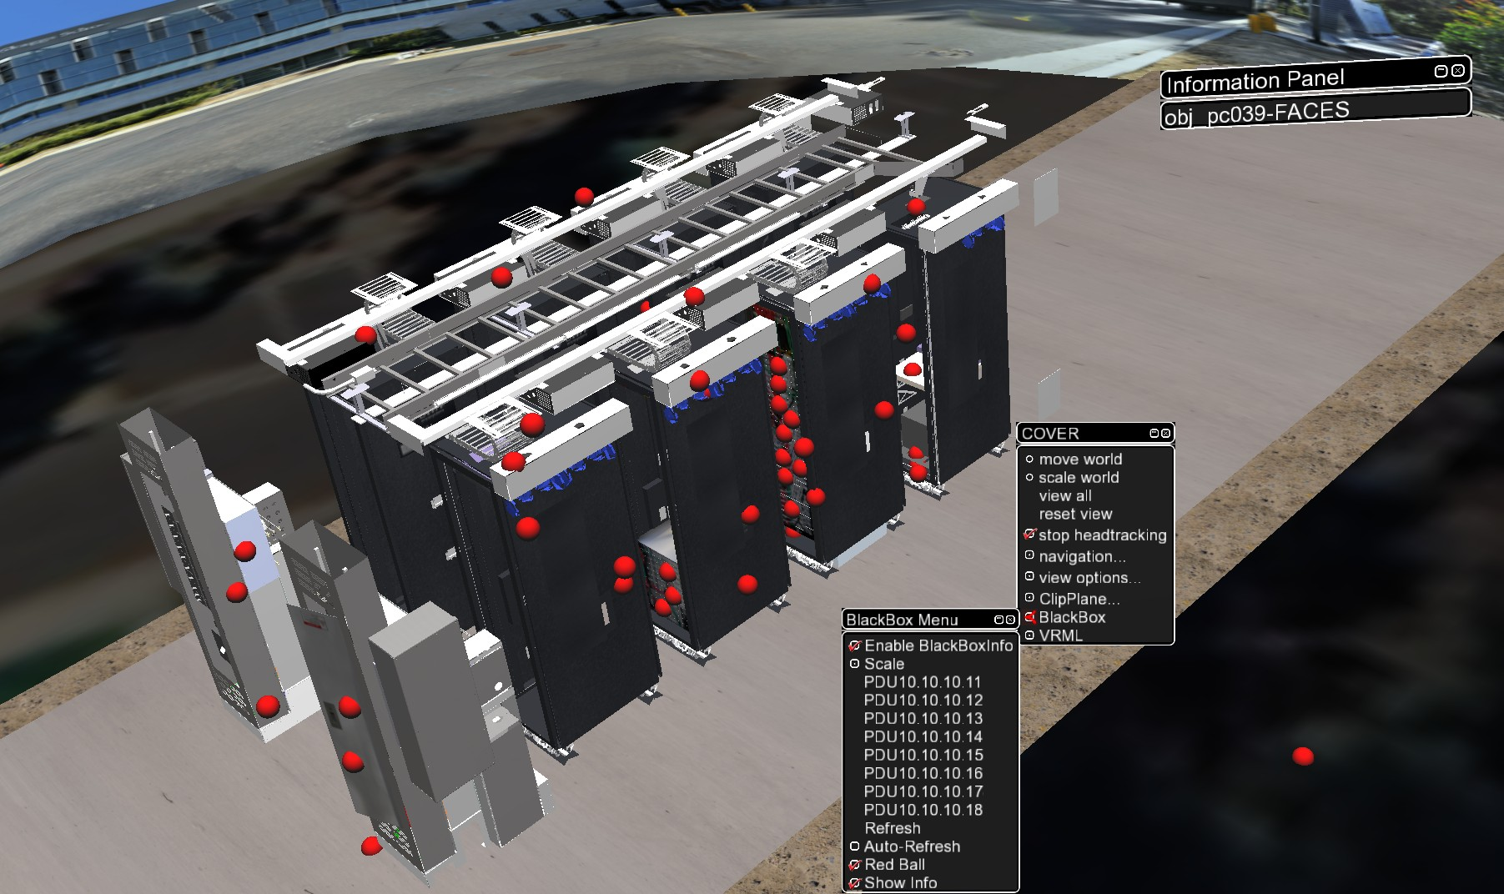
Interactive Component Selection

Slide 7
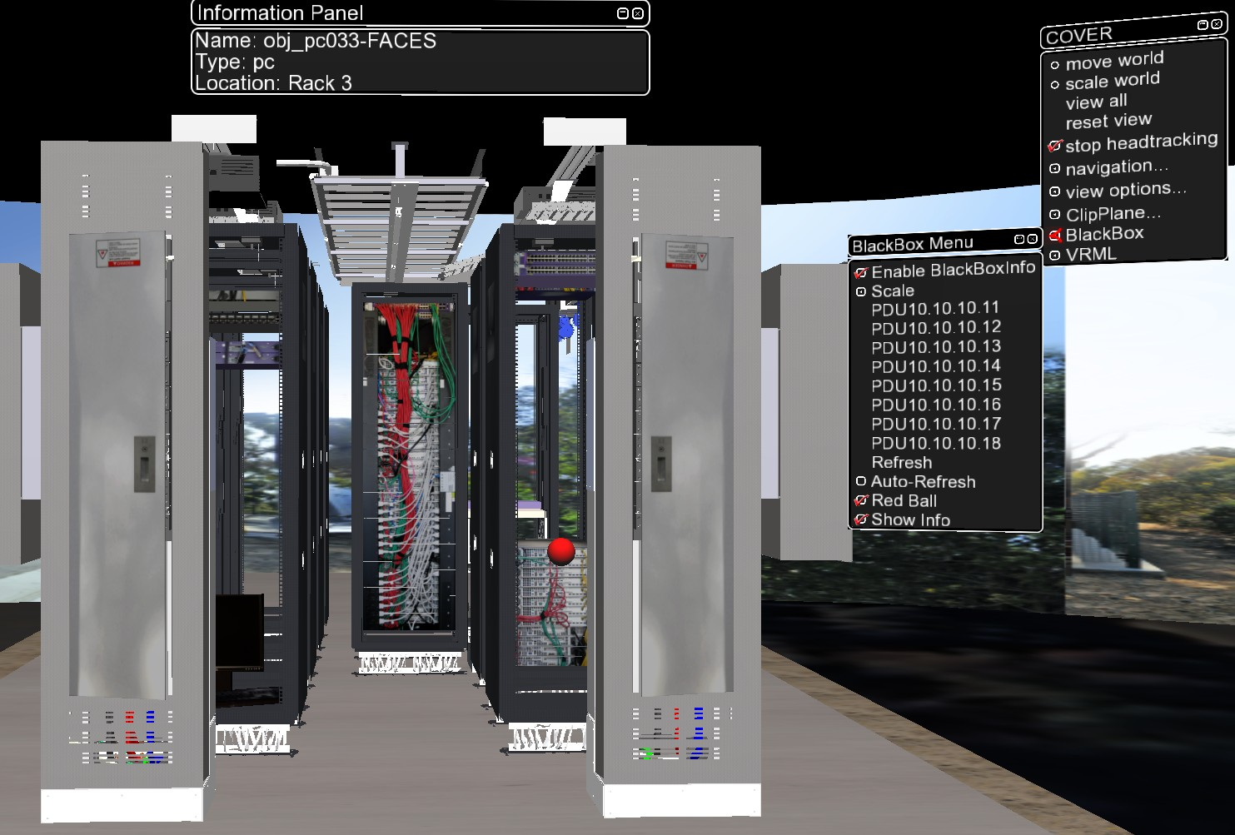
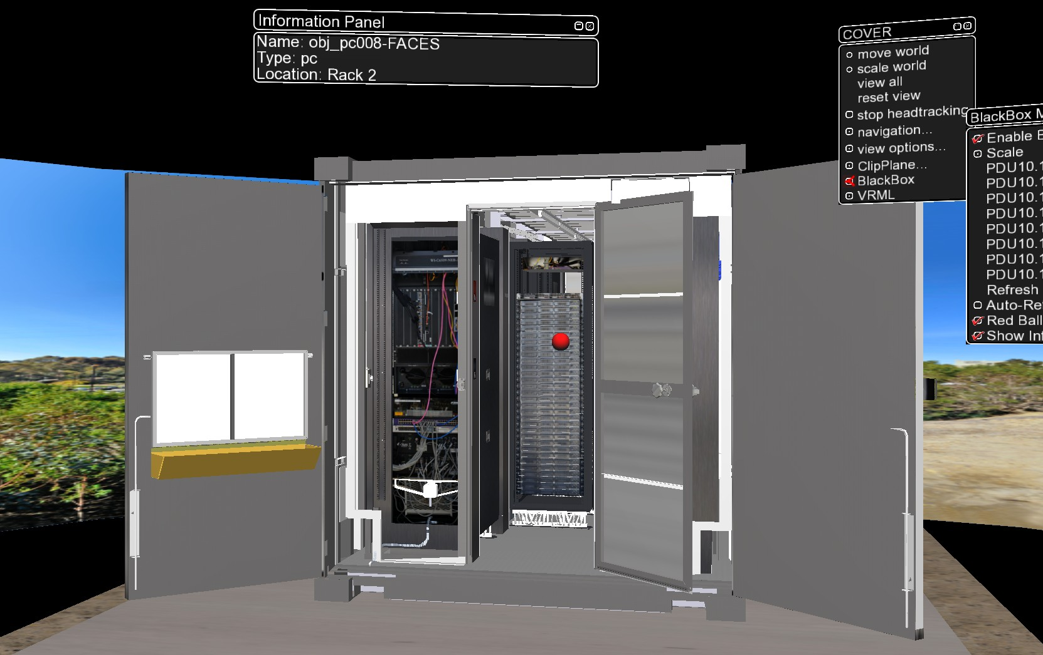
Interactive Component Selection
3D mouse cursor selects component of interest (PC, switch, PDU, etc.)
Each unit has unique ID
Visualization tool has data bank of all components and displays name, type, location.

Slide 8
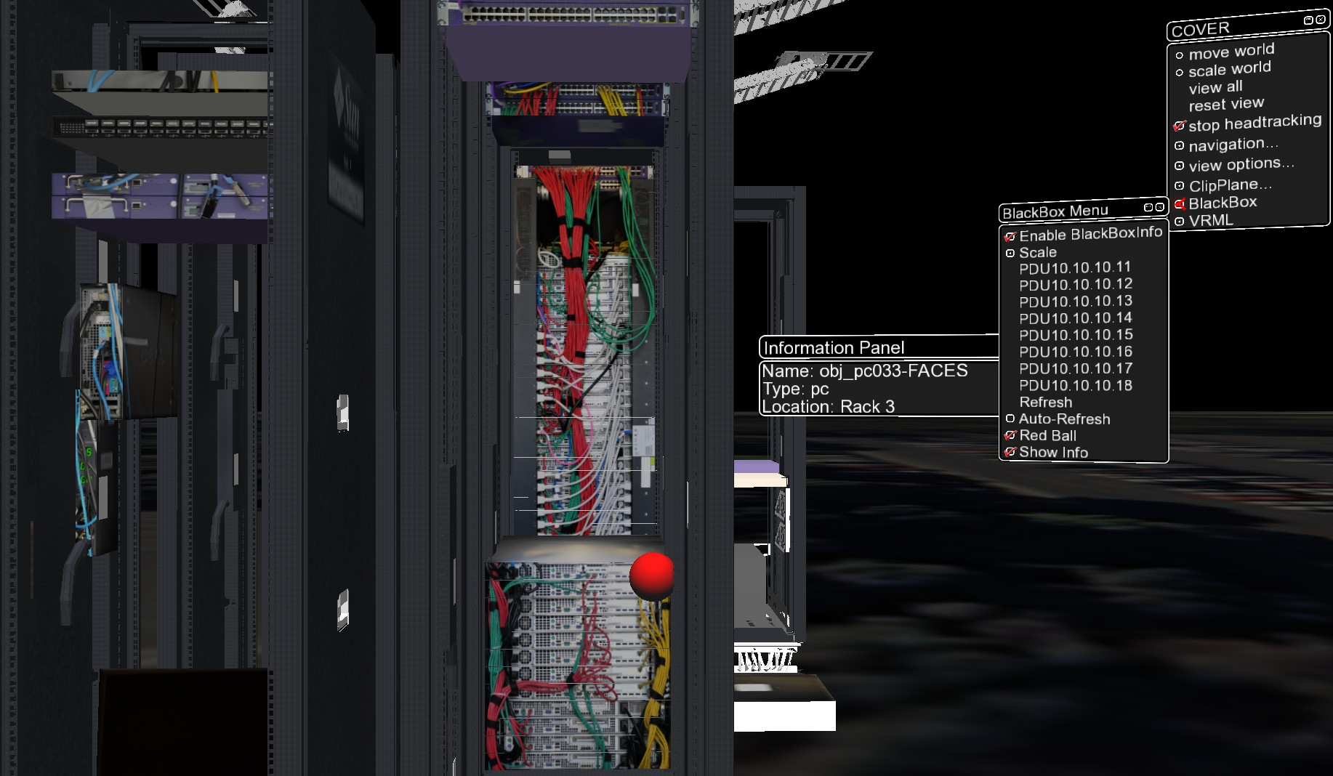
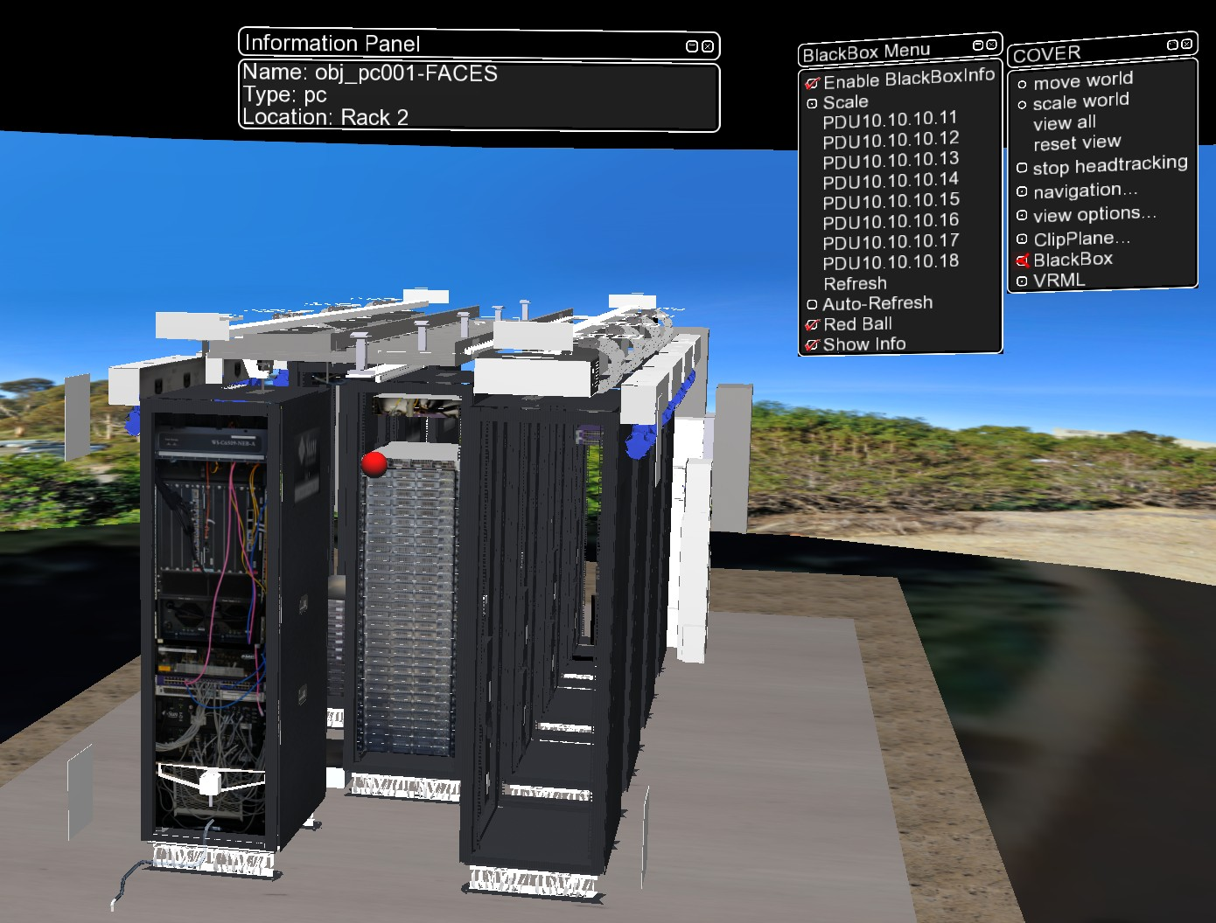
Future Work
Access more sensor data:
power consumption of individual nodes
fan speed
CPU temperature
Create self-explanatory interactive visualization tool
Run permanently on dedicated display hardware for researchers to access at all times

