Slide 1
Financial Derivatives in Grid Computing and Beyond
Presented by
Jonatan Gonzalez
Melita Jaric

Slide 2
Overview
Jonatan Gonzalez introduction
Project Overview
Intermixing Finance and Computer Science
Global Connections and REU Goals
Jonatan Gonzalez Presentation
REU Benefits
Boost /MPI / Timing
What’s Next?

Slide 3
Jonatan Gonzalez
Introduction
REU Benefits
Global Connection
Overview of Project
Boost
MPI
Excel
Timing

Slide 4
Introduction, Benefits and Global Connections
Senior undergraduate student
Future direction
Resume building
Exposure to applications and current trends in industry
Exposure to different working cultures and communication environments

Slide 5
Project Overview from a Software Designer
Financial vocabulary:
Stock Options
Puts: exercise max(E-S(T), O)
Calls: exercise max(S(T)-E, O)
Hedge style: European, American, Asian
Interest rate
Volatility
Greeks – Derivatives with respect to time, price and volatility, interest rate
Randomness, risk (un)predictability

Slide 6
Non Functional Requirements
Precision
Efficiency
Reliability
Security
Scalability

Slide 7
Software Tools
C++/Java
STL / Boost
Threads
MPI
Grid
Cloud Computing

Slide 8
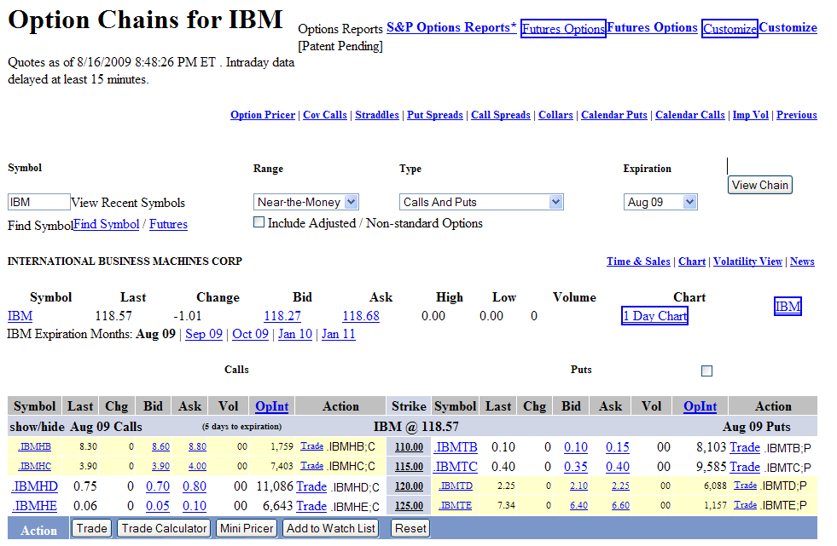
Financial Views and Excel

Slide 9
Where are we now?
Time Sequential Code
Why?
Parallelization overhead
Why time all of the methods separately?
Timing Issues

Slide 10
Timing Table
nTime | nTime Time | nTime * 2 Time | nTime * 6
480 | .93 seconds | 3.83 seconds | 37.16 seconds
480 * 5 | 23.9 seconds | 129 seconds | -2438.15 seconds
480 * 5 * 4 | 705.89 seconds | -760.027 seconds | 1488.34
480 * 5 * 12 | 210.485 seconds | 1302.37 seconds
Negative Numbers indicate overflow
This is solved by a simple calculation
-760.027 becomes 3534.9403
-2438.15 becomes 1856.8173

Slide 11
Timing Explained
Clock_t is 32 bit unsigned, with maxValue=0xffffffff
Measures number of CPU clock cycles since the start of the program
Negative numbers indicate the following sequence of events: start_time followd by clock_t going over maxValue followed by end_time.
In this case:
time_diff = maxValue-start_time+end_time

Slide 12
What’s Next?
Finish timing all the models in sequential code
Port code into Grid
Time in Grid
Multithread the code
Time / understand / predict parallelization overhead
Experiment with MapReduce
Experiment with Cloud computing

